Slide 1

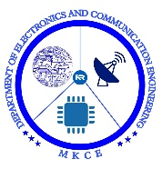

DEPARTMENT OF ELECTRONICS AND COMMUNICATION ENGINEERING
IYAL : REAL - TIME VOICE TO TEXT COMMUNICATION FOR THE DEAF
PRESENTED BY:
Subiksha K (927622BEC210)
Swathi D (927622BEC225)
Vennila V (927622BEC247)
Vishnu Bharathi J (927622BEC250)
GUIDED BY,
Mrs T Balamani

Slide 2
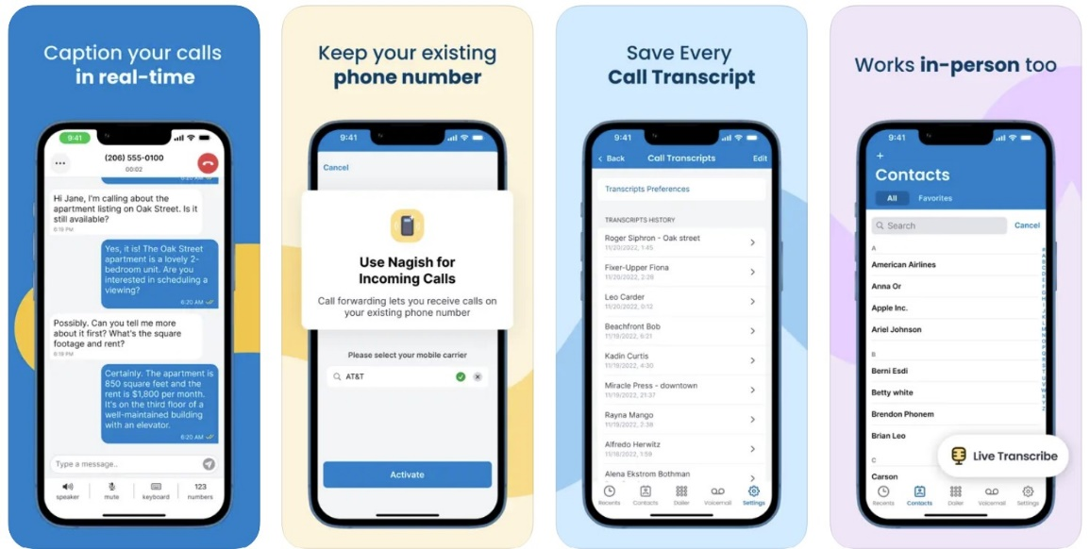
OBJECTIVE
To provide a real-time voice-to-text and text-to-voice conversion service for people who are unable to communicate due to hearing and speech disability.
This will enhance their communication capabilities and make various areas more inclusive and accessible

Slide 3
ABSTRACT
The Iyal app is a real-time communication tool designed to assist those who are hard of hearing or deaf in daily situations, much like the Nagish app. Through speech-to text translation and vice versa, Iyal ensures seamless communication in both personal and professional contexts. Because the software is bilingual, users may communicate with ease regardless of the language being spoken. Its advanced AI speech recognition and text-to-speech algorithms produce accurate translations in real time. Reversible font sizes and background colors are among the adjustable accessibility options that Iyal provides to further meet various needs. This user-friendly program can assist the deaf population become more connected and autonomous, which will increase social engagement and facilitate conversations.

Slide 4
INTRODUCTION
Deaf individuals often struggle with traditional phone calls, relying on relay services that can be slow and compromise privacy. Voice-to-text apps provide instant transcriptions, enabling private, real-time communication without intermediaries, enhancing independence and accessibility.
With features like multilingual support and customizable interfaces, these apps cater to diverse needs. They empower users to manage personal and professional interactions seamlessly, ensuring inclusivity and strengthening connections through flexible, real-time conversations.

Slide 5
LITERATURE SURVEY (IN TABLE FORMAT)
Study/Author | Key Findings
Li et al. (2018) | Real-time speech-to-text transcription systems enable seamless communication for the deaf community.
Ahmed et al. (2021) | Development of multilingual speech recognition systems enhances cross-language communication, fostering inclusivity.
Meyer et al. (2019) | Google Speech-to-Text API supports over 100 languages, providing multilingual real-time transcription.
Chen et al. (2020) | Text-to-speech systems enable two-way communication, converting text input into speech for a more interactive experience.
Johnson & Wang (2020) | User-centric design, including customization options, ensures the app remains practical for a diverse user base.
Park et al. (2021) | Eliminating reliance on relay systems enhances privacy and speed in communication, especially for sensitive conversations.
Nagish App | Successful implementation of real-time voice-to-text communication eliminates the need for relay services.

Slide 6

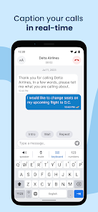
EXISTING METHOD/PROBLEM STATEMENT
Nagish App
Nagish is a free app that uses AI to provide real-time captioning for phone calls, allowing people who are deaf or hard of hearing to communicate.
Convert audio into highly accurate real-time text and vice versa in six languages.
English, Spanish, French, Japanese, Hebrew, and Italian.
This allows for use even in noisy environments, and ensures privacy.

Slide 7
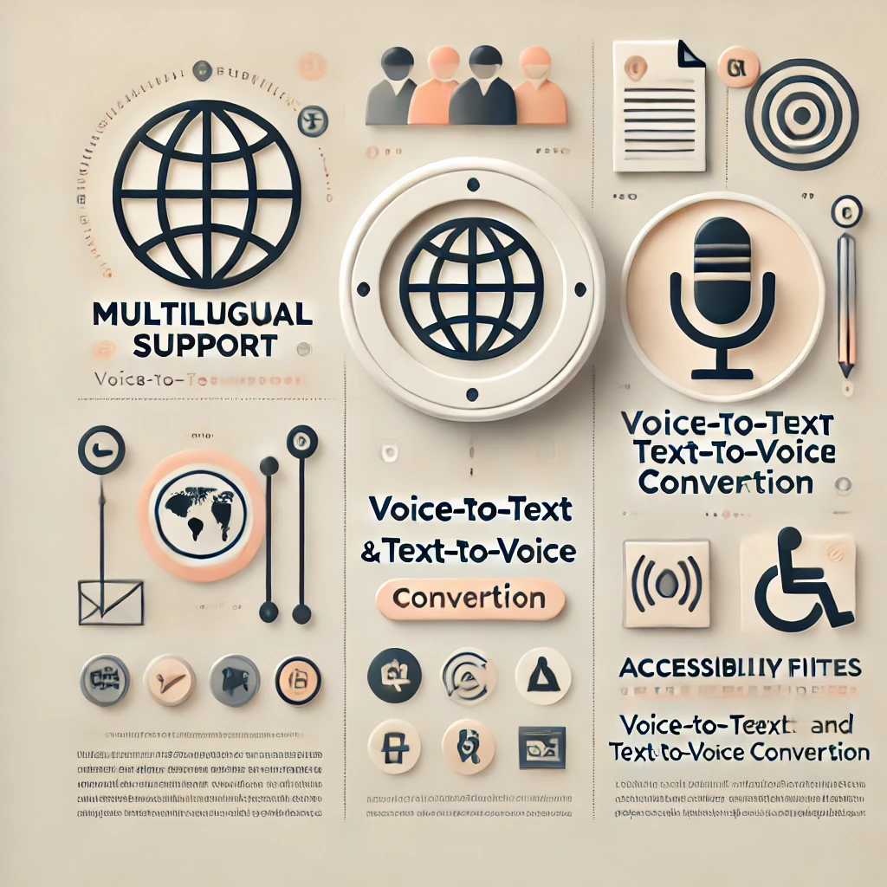
PROPOSED METHOD
The proposed system of the Indian version of the Nagish app is designed to cater to the unique communication needs of the hearing-impaired population in India.
It aims to provide an accessible platform that offers real-time conversion of speech to text (STT) and text to speech (TTS) in multiple Indian languages, ensuring easy communication for people with hearing disabilities.
Uniqueness
Multilingual Support
Voice-to-Text and Text-to-Voice Conversion
Accessibility Features
User-Friendly Interface
Offline Functionality

Slide 8
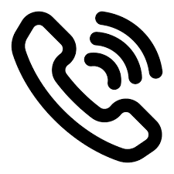
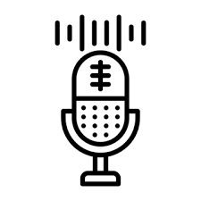
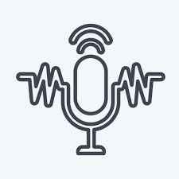
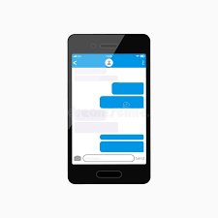



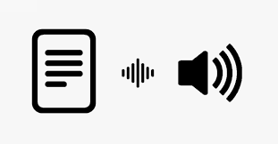


BLOCK DIAGRAM/ FLOW CHART/ ALGORITHM/ CIRCUIT DIAGRAM
Call Iniatiation
Voice Capture
Speech recognition
Text Display
Call Termination
Privacy Protection
Real time Processing
Text to Speech
Deaf response

Slide 9
RESULT & DISSCUSSION
The Nagish app has significantly improved accessibility for users with speech or hearing impaired communities. Users report higher satisfaction due to accurate translations and customizable features, which support seamless integration into personal and professional interactions.
By empowering users with greater independence, it bridges communication gaps and promotes equity. Expanding to additional languages and ensuring robust data privacy could further enhance its impact and set a stronger standard for accessible innovation.

Slide 10
CONCLUSION & FUTURE WORK
The Nagish app offers hope to individuals with speech or hearing difficulties, particularly Tamil and Malayalam speakers, by combining technology with cultural sensitivity. It promotes language pride, removes communication barriers, and ensures equitable participation.
By addressing linguistic needs, Nagish exemplifies inclusivity through innovation. Its real-time text-to-speech and speech-to-text features empower users, setting a benchmark for accessible technology and fostering a diverse, inclusive society.

Slide 11
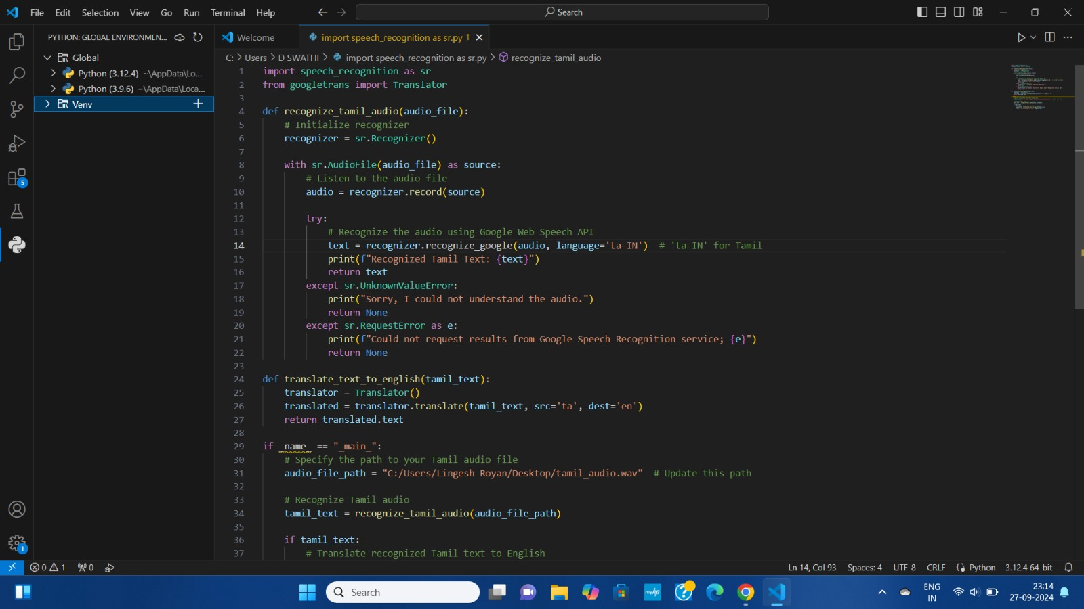
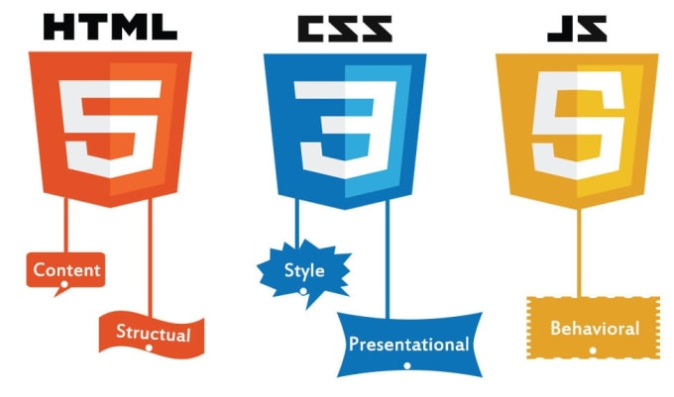
TOOL USED
HTML
CSS
PYTHON
JAVA SCRIPT

Slide 12
ADVANTAGES
Quality of Life
Greater independence and opportunities
IYAL
https://codepen.io/VISHNURATAN/pen/ogvXZPB
Increased Inclusion
Promote greater inclusion of individuals such as education, employment, and social interactions
Empowerment
By providing a tool for effective communication, the app can empower individuals with disabilities, boosting their confidence and self-esteem
Accessibility
More accessible for individuals with disabilities, breaking down barriers and promoting equality
Communication enhancement
Interact more effectively with others

Slide 13
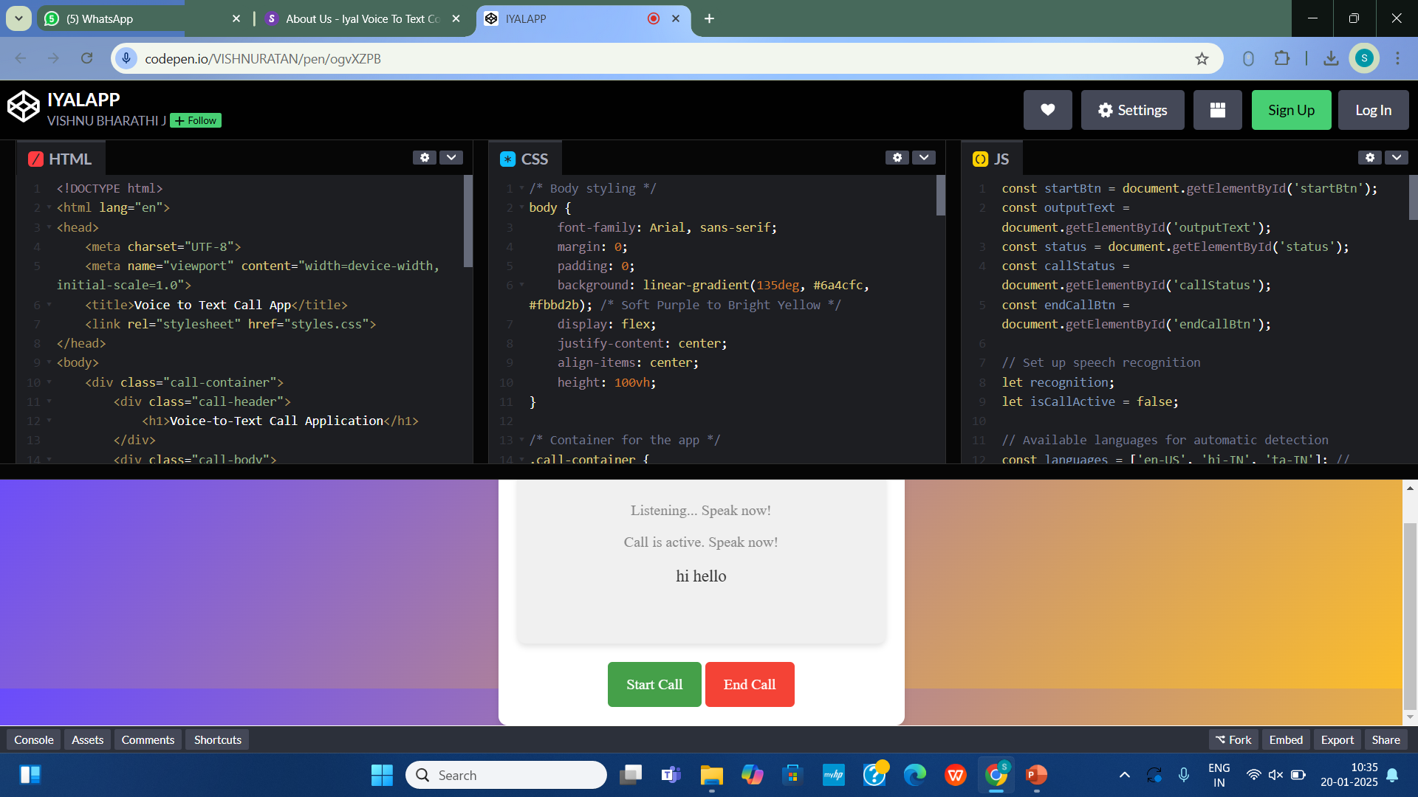

Slide 14
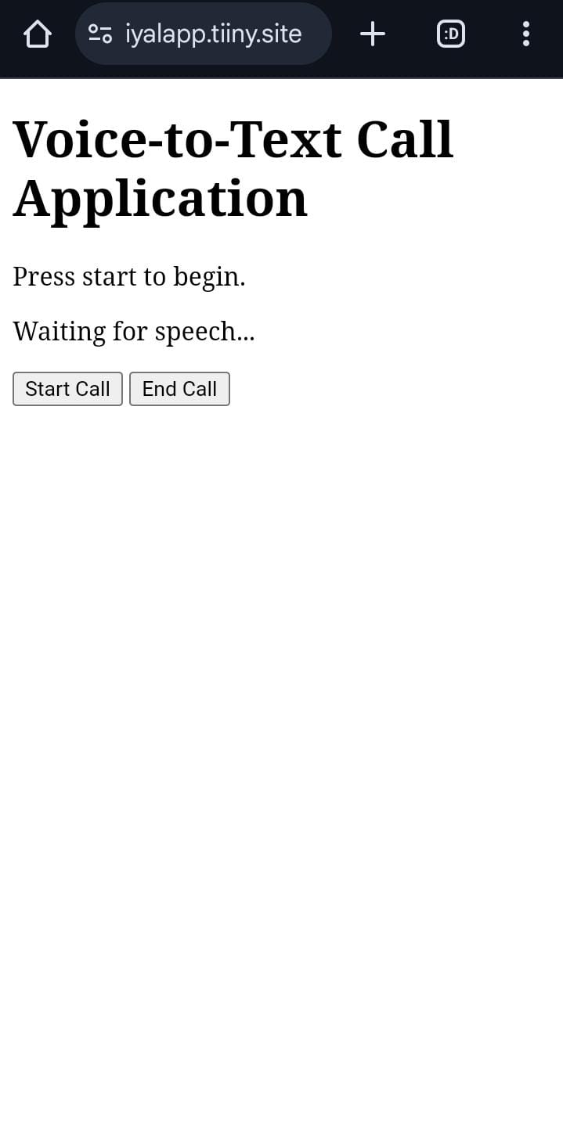
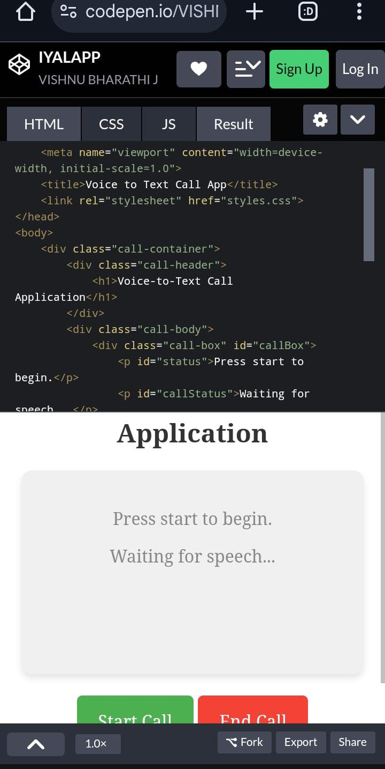
APPLICATION
Increased Autonomy and Independence
2. Multilingual Support
3. Improved Social and Professional Interaction
4. Accessibility and Customization
5. Reduced Dependence on Traditional Methods
6. Support for Multiple Contexts

Slide 15
REFERENCES
Siri, Cortana, AlexaAmrita S.Tulshan(&)and Sudhir Namdeorao Dhage Department of Computer Engineering, Sardar Patel Institute of Technology, Mumbai 400058, Indiaamrita.tulshan@spit.ac.in, https://nagish.com/post/nagish-benefits-and-features
Manjusha Jadhav, Krushna kalyankar, Ganesh Narkhede, Swapnil Kharose, Survey On Smart Virtual Voice Assistant, Volume:09 Issue:01|Jan2022
https://zeroproject.org/view/project/fbb37452-8e20-48ae-9068-04452c512781
https://www.prnewswire.com/news-releases/nagish-raises-16-million-to-revolutionize-communication-for-individuals-with-hearing-loss-through-ai-302192713.html

Slide 16


